Slide 1

Object Detection
Object detection
deeplearning.ai

Slide 2
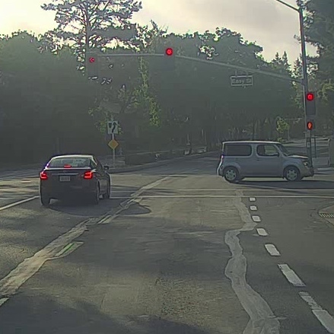


Car detection example
Training set:
x
y
1
1
1
0
0

Slide 3
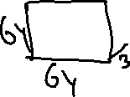

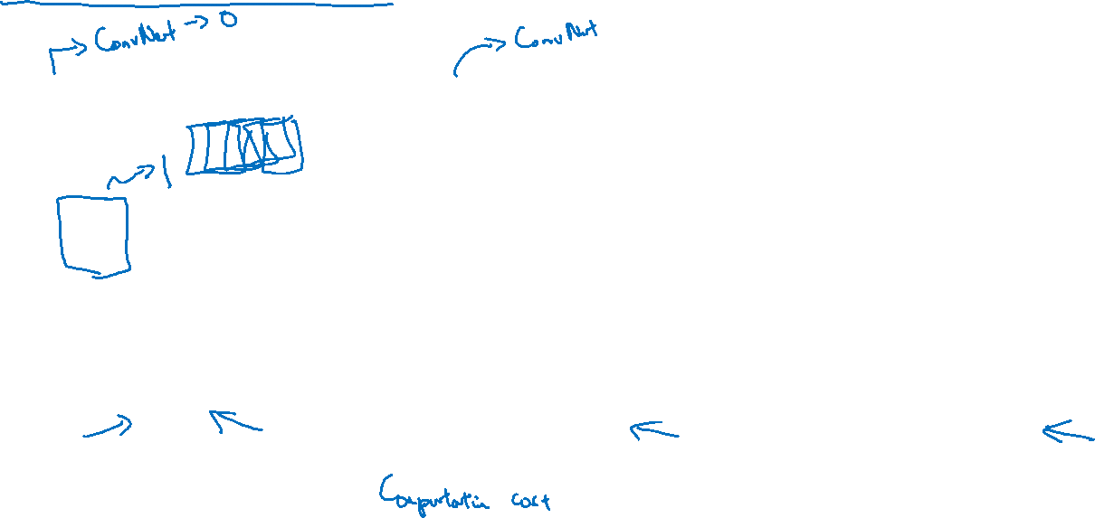

Sliding windows detection

